Slide 1

Introduction to Machine Learning with H2O
Jo-fai (Joe) Chow
Data Scientist
joe@h2o.ai
Paris Machine Learning Meetup
Murex
21st September, 2016

Slide 2
About Me: Civil Engineer → Data Scientist
2005 - 2015
Water Engineer
Consultant for Utilities
EngD Research
Machine learning + Water Engineering
Discovered H2O in 2014!
2015 - Present
Data Scientist
Virgin Media (UK)
Domino Data Lab (US)
H2O.ai (US)
Why? Long story – see bit.ly/joe_h2o_talk2

Slide 3
Agenda
This Talk (40 mins)
About H2O.ai
Demos
Web & R Interface
Why H2O?
What’s Next?
New developments
Second Talk (30 mins)
Deep Water
Demos
H2O + mxnet
H2O + TensorFlow
Third Talk (45 mins)
H2O + Spark = Sparkling Water
Demos
H2O + Spark MLlib

Slide 4
Tweets
Paris Machine Learning Applications Group
@ParisMLGroup
Murex
@Work_at_Murex
#MurexParis
H2O.ai
@h2oai
Joe
@matlabulous

Slide 5
About H2O.ai

Slide 6
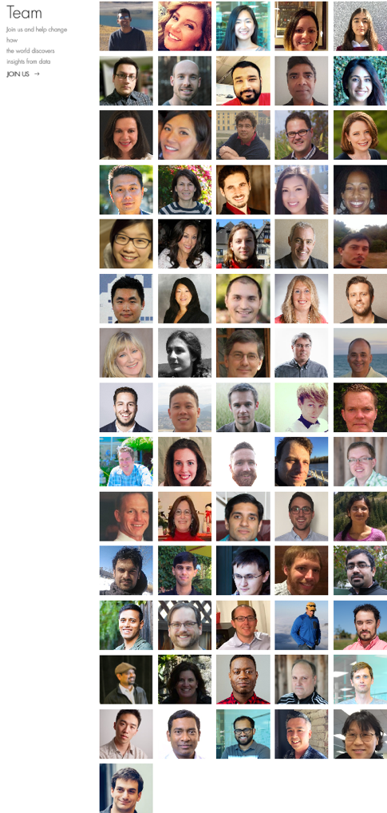
About H2O.ai
H2O.ai, the Company
Team: 80 (71 shown)
Founded in 2012
HQ: Mountain View, California
H2O, the Platform
Open Source (Apache 2.0)
R, Python, Scala, Java and Web Interfaces
Distributed Algorithms that Scale to Big Data
Works with Laptop, Hadoop & Spark
Jakub
(Kuba)
Joe

Slide 7
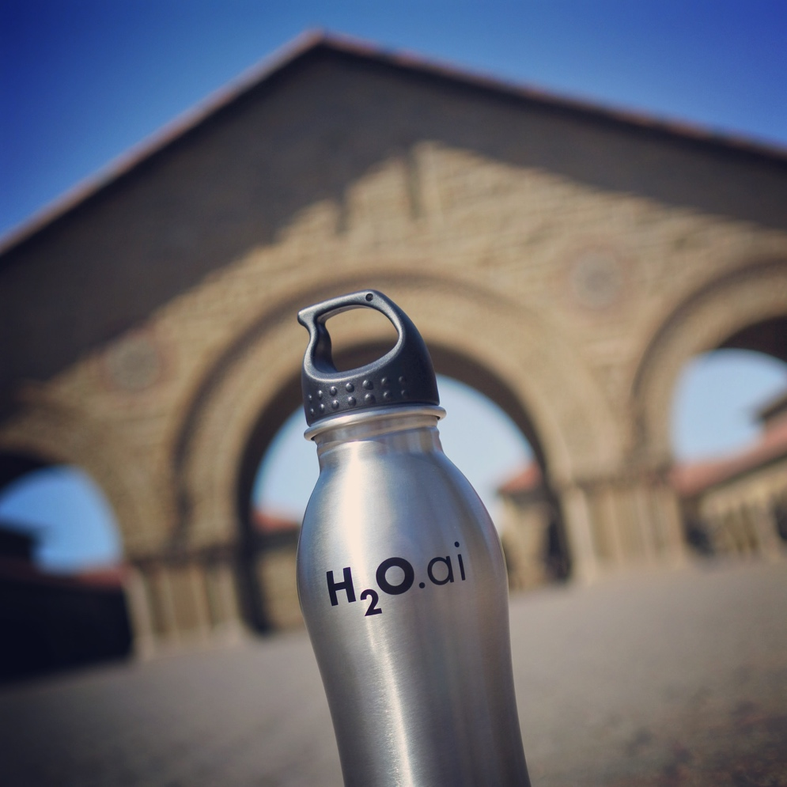
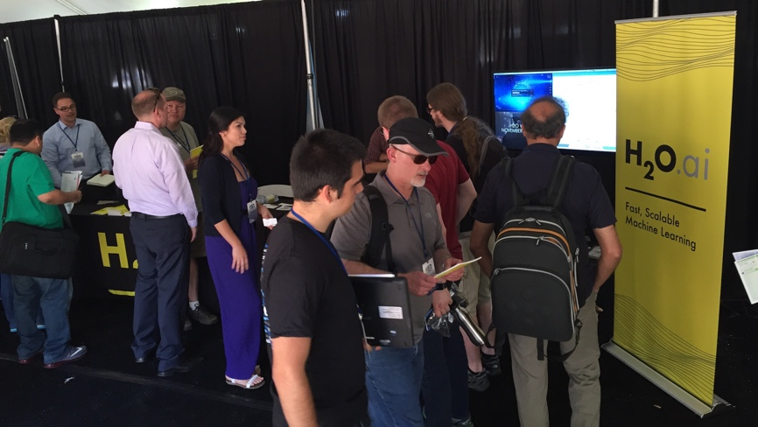
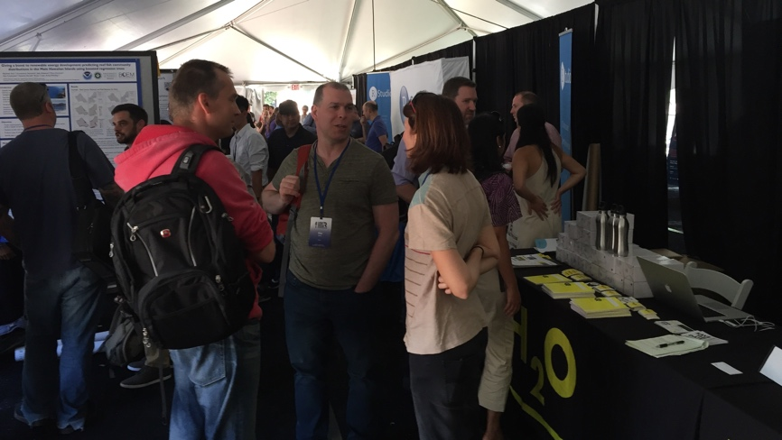
H2O.ai & Stanford University
useR! 2016 Conference at Stanford

Slide 8


Scientific Advisory Council

Slide 9
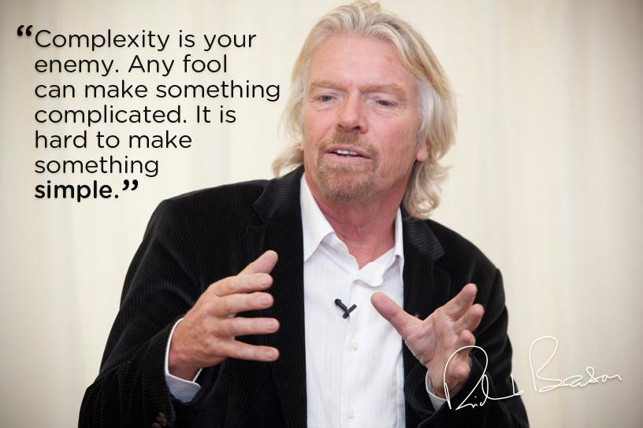
H2O’s Mission
Machine Learning for EVERYONE
Photo credit: Virgin Media

Slide 10







H2O Platform Overview
Core algorithms written in high performance Java.
Fast, distributed and scalable.
APIs available in R, Python, Scala, REST/JSON and web.
Works with laptop, cloud, Hadoop and Spark

Slide 11
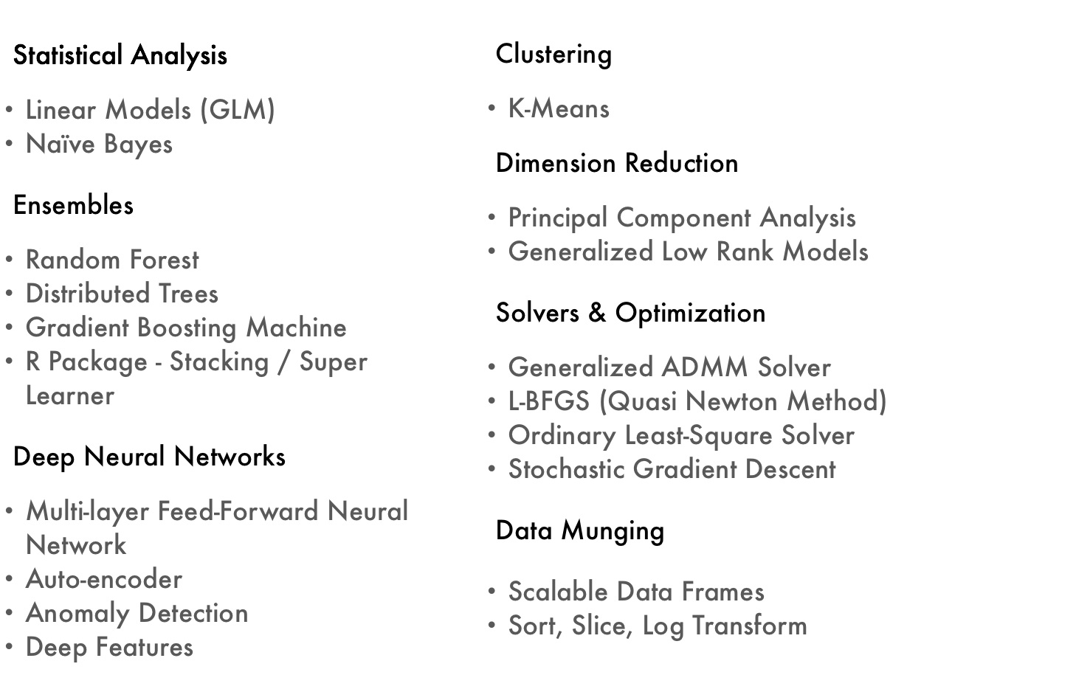
Current Algorithm Overview
Joe’s Strata Hadoop
London Talk
bit.ly/joe_h2o_talk4
Web & R
Demos
Joe’s LondonR Talk
bit.ly/joe_h2o_talk3

Slide 12
H2O Demos

Slide 13
H2O Demos
Demo 1: Web Interface
Public dataset
Import data
Explore data
Build & evaluate models
Make predictions
Demo 2: R Interface
Same process using R script

Slide 14

Public Dataset – Wine Quality
Photo credit: 28.media.tumblr.com

Slide 15
Public Dataset – Wine Quality
11 Features
Characteristics of wine
Acidity, Sugar, pH ... etc.
1 Output
Quality (0 – 10)
Classification / Regression
4898 Records
White wine
UCI Machine Learning Repository
http://archive.ics.uci.edu/ml/datasets/Wine+Quality
CSV
http://archive.ics.uci.edu/ml/machine-learning-databases/wine-quality/winequality-white.csv

Slide 16
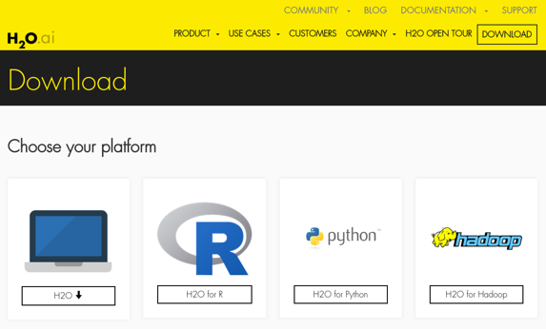
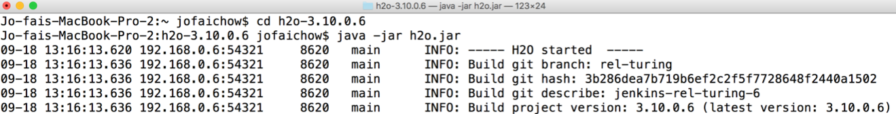
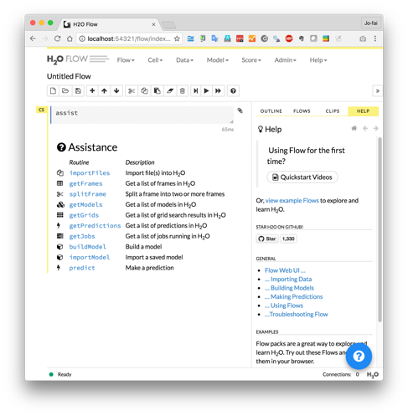
H2O Flow (Web Interface) Demo
Download and unzip jar from www.h2o.ai
In terminal:
java -jar h2o.jar
Web browser:
localhost:54321

Slide 17
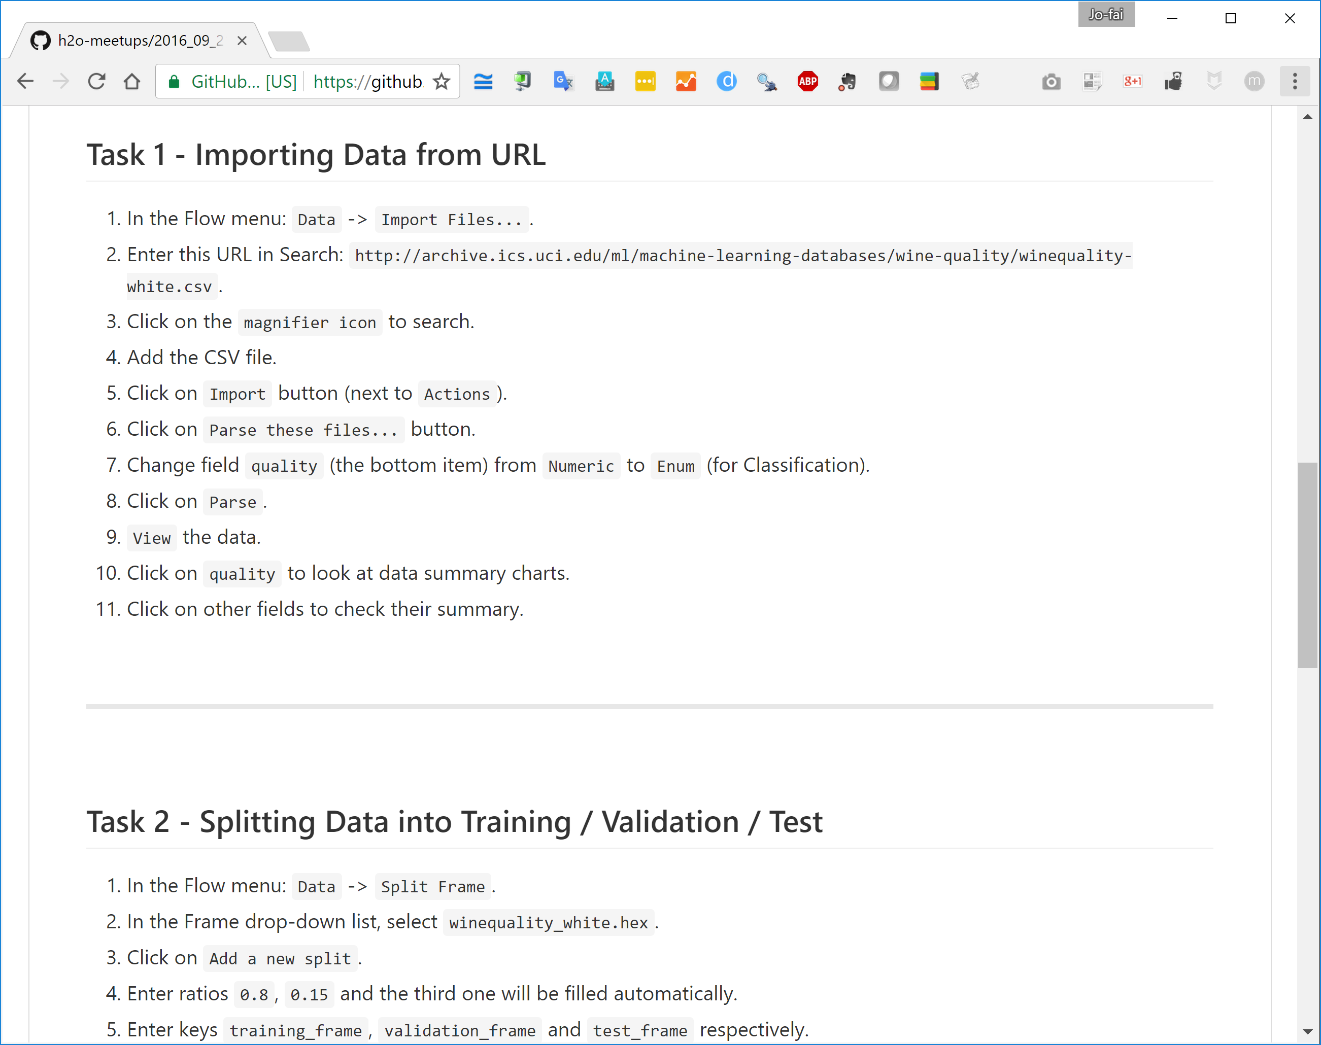
H2O Web Interface – Live Demo
For online audience
Go to this GitHub repo bit.ly/h2o_paris_1
Go to sub-folder demo_01_flow
Following the procedures in README.md

Slide 18
H2O Flow Live Demo

Slide 19
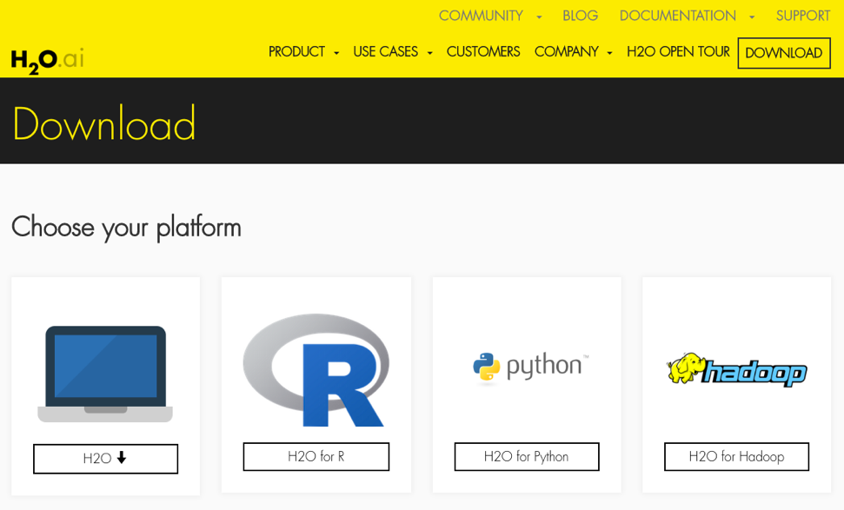
H2O R Package Demo
Install latest stable
Recommended method
See instructions on webpage
Install from CRAN
install.packages(”h2o”)

Slide 20
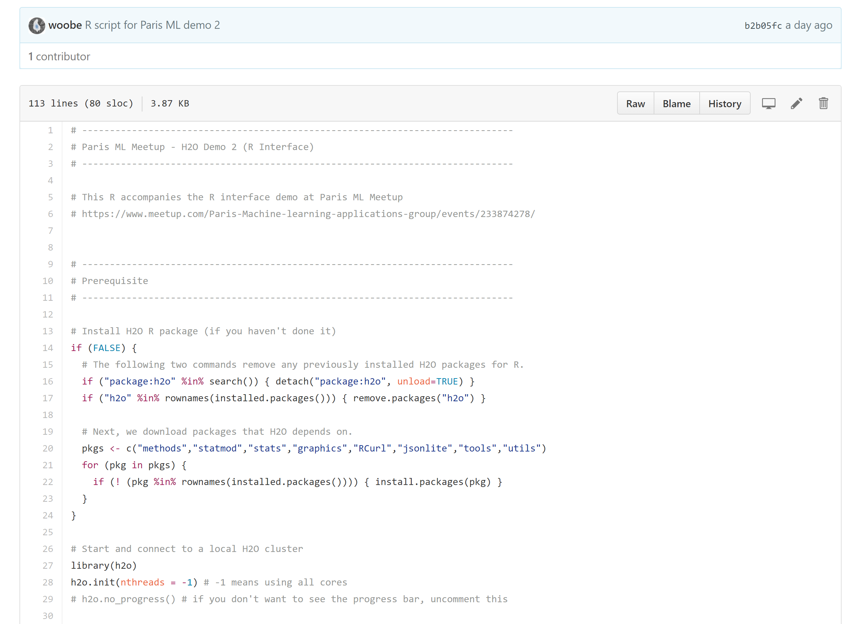
H2O R Interface – Live Demo
For online audience
Go to this GitHub repo bit.ly/h2o_paris_1
Go to sub-folder demo_02_r
Download and run R scripts.

Slide 21
H2O + R Live Demo

Slide 22
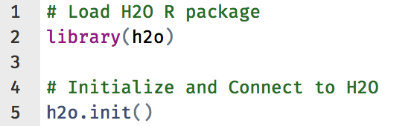
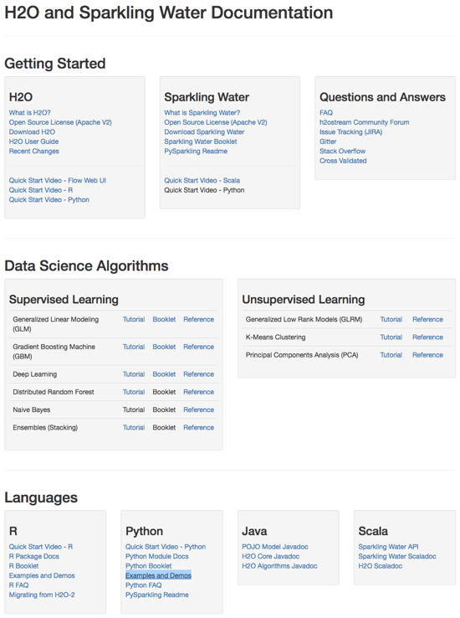
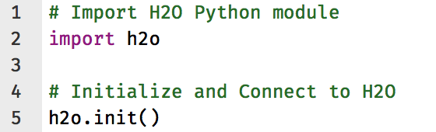
Other H2O Interfaces
R
Python
Resources - docs.h2o.ai

Slide 23
More Advanced Topics
Advanced Features:
Hyperparameters Tuning
Model Stacking
Saving/Loading Models
Export Plain Old Java Object (POJO)
Resources:
bit.ly/h2o_budapest_1
bit.ly/joe_h2o_talk3
docs.h2o.ai

Slide 24
Why H2O?

Slide 25
Quote from our CEO
“Software is eating the world and artificial intelligence (AI) is eating software, as traditional rules-based models no longer cut it in today’s rapidly changing world.”
– Sri Ambarti, CEO and Co-founder, H2O.ai

Slide 26
H2O Overview
26

Slide 27
H2O’s Mission
Machine Learning for EVERYONE
Photo credit: Virgin Media

Slide 28
H2O Community

Slide 29
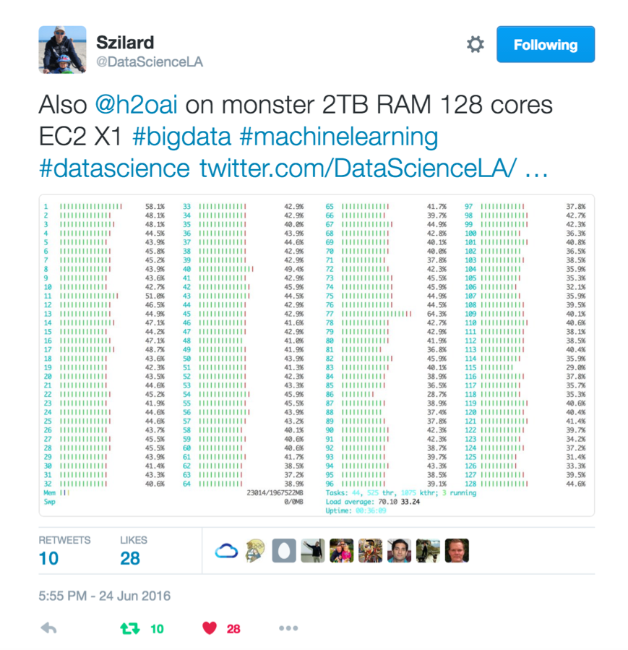
Szilard Pafka – ‎Chief Data Scientist at Epoch
Sziland’s talks / blog posts about H2O:
ML Benchmark
Intro to ML with H2O
H2O Scoring
Tweets

Slide 30
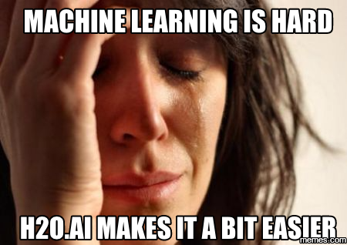
Szilard Pafka – Why H2O?
Szilard’s Summary Slide

Slide 31
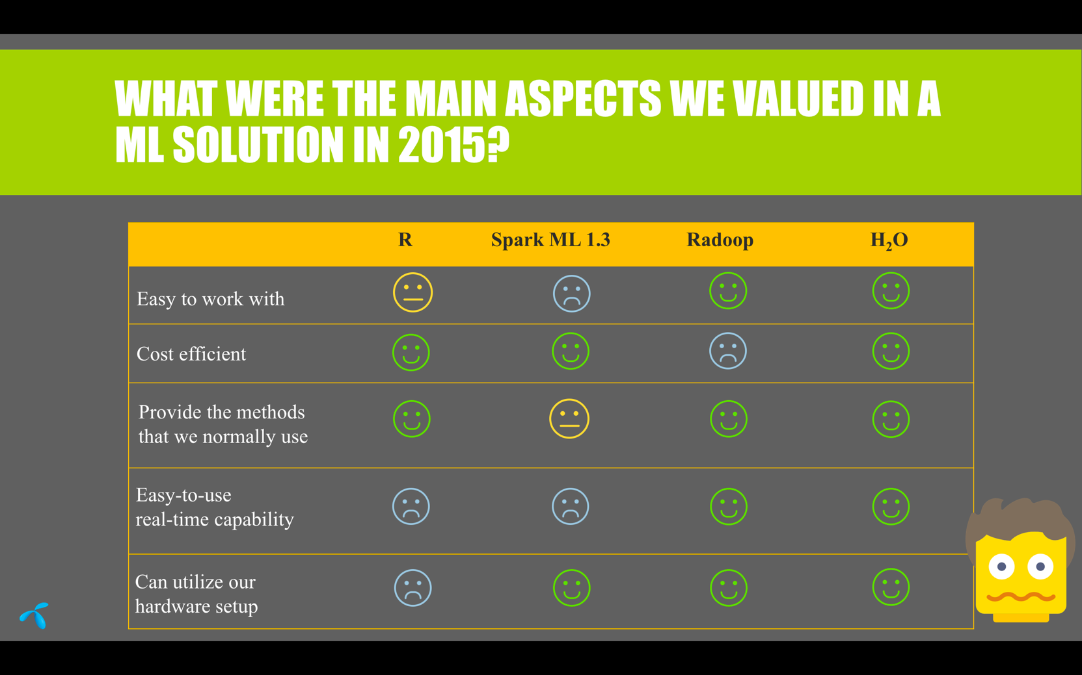
Telenor (Telecom in Hungary) – Why H2O?

Slide 32
H2O for Kaggle

Slide 33

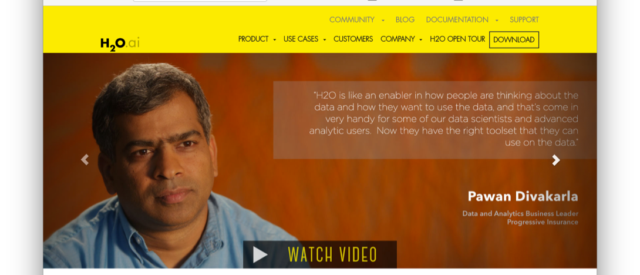
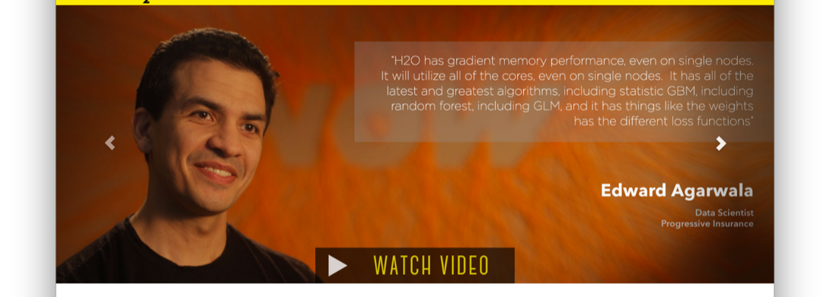
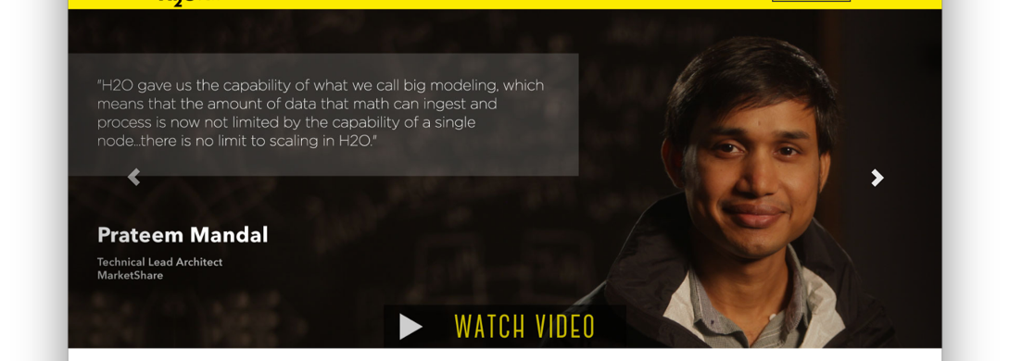
H2O Customers
Check out the videos - www.h2o.ai

Slide 34
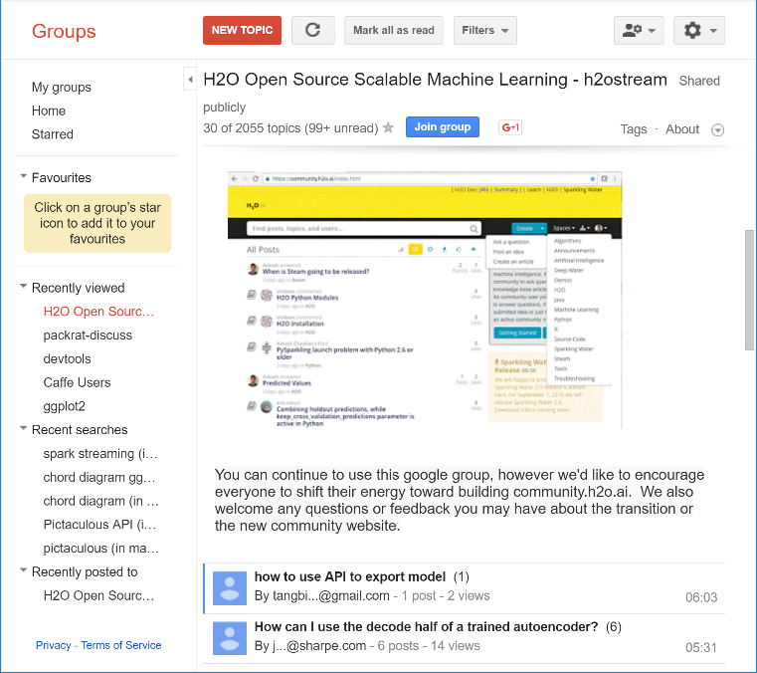
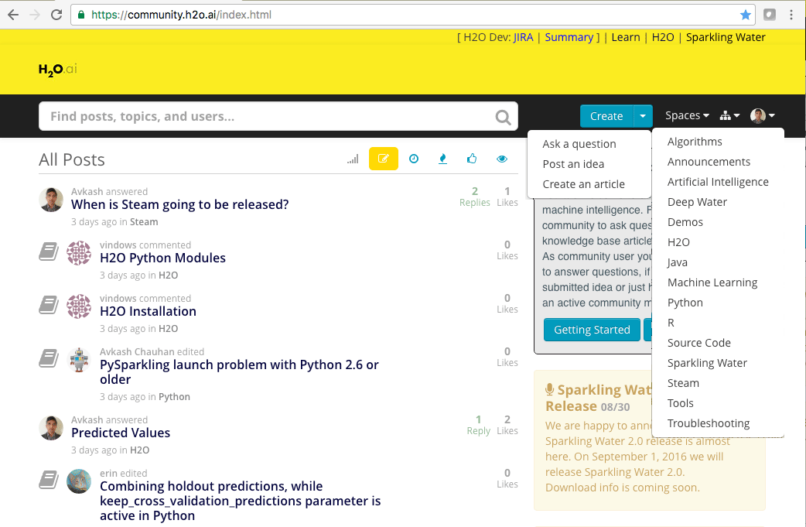
H2O Community Support
Google forum – h2osteam
community.h2o.ai

Slide 35
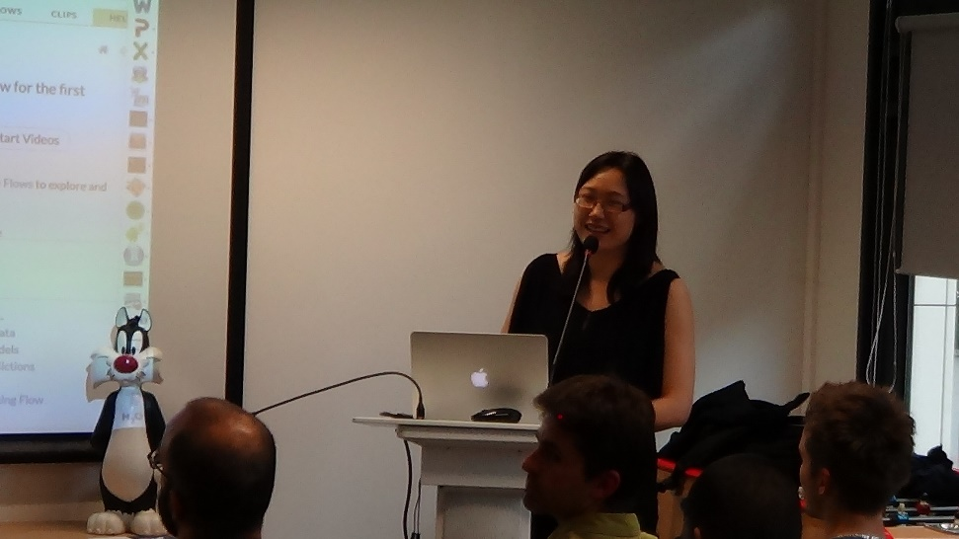
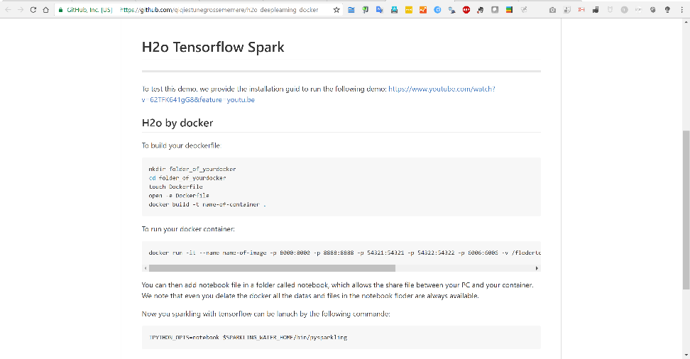
H2O Community in Paris
Your local H2O expert is here – Jiqiong (Ji) Qiu
Docker for H2O + TensorFlow demo

Slide 36
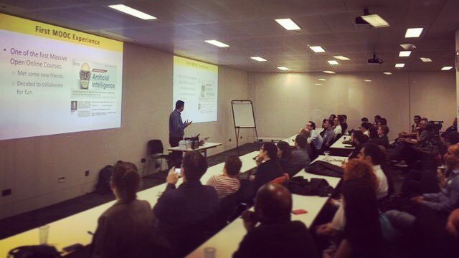
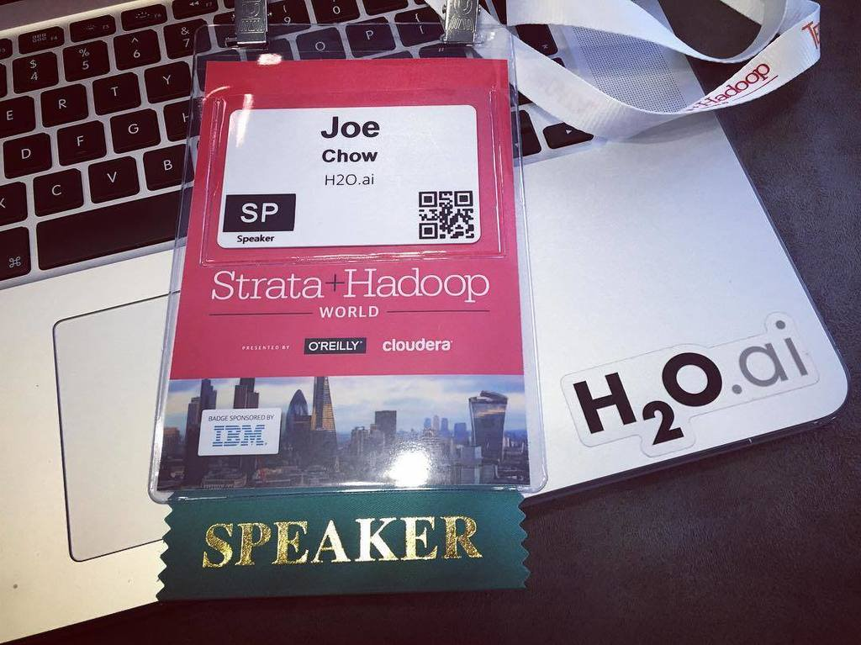
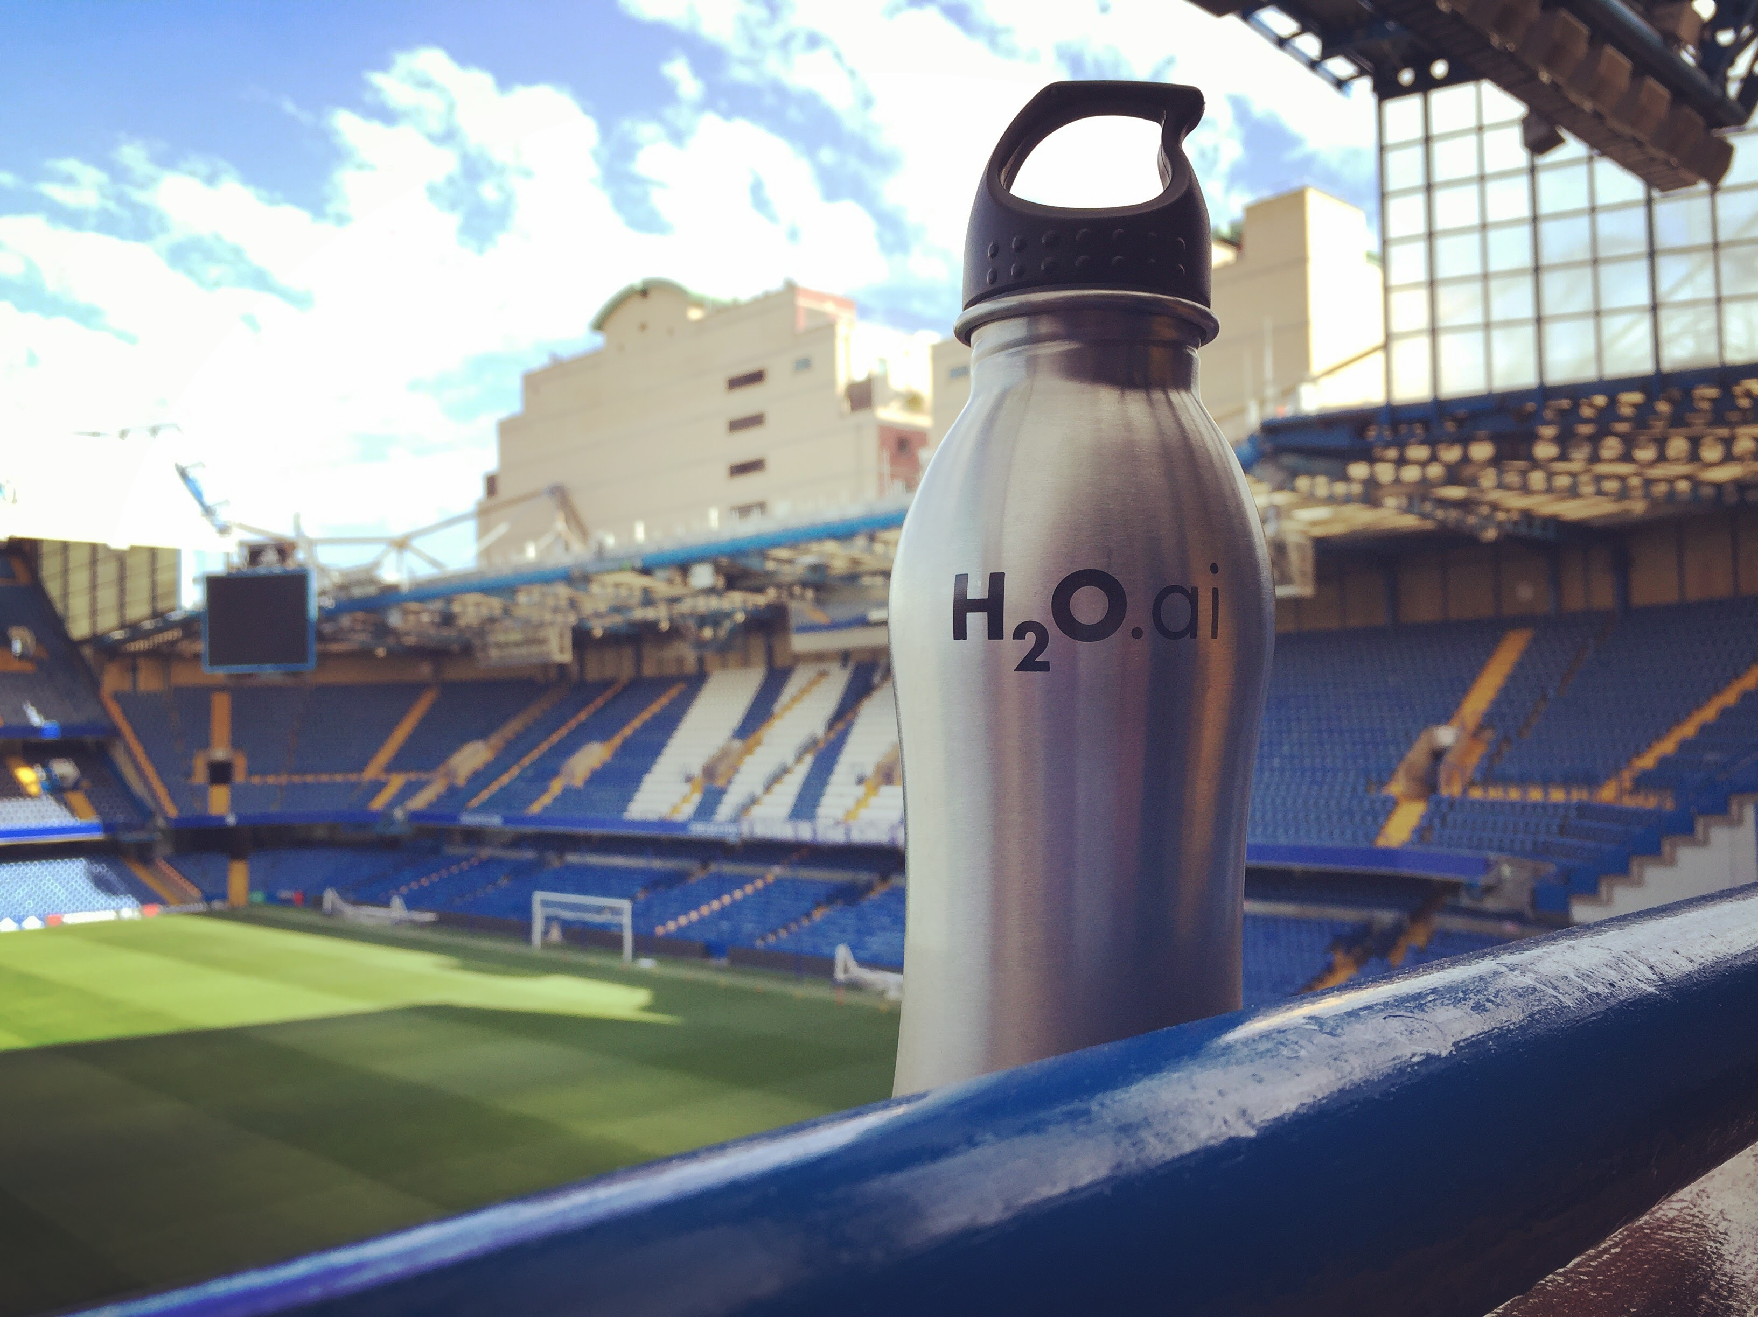
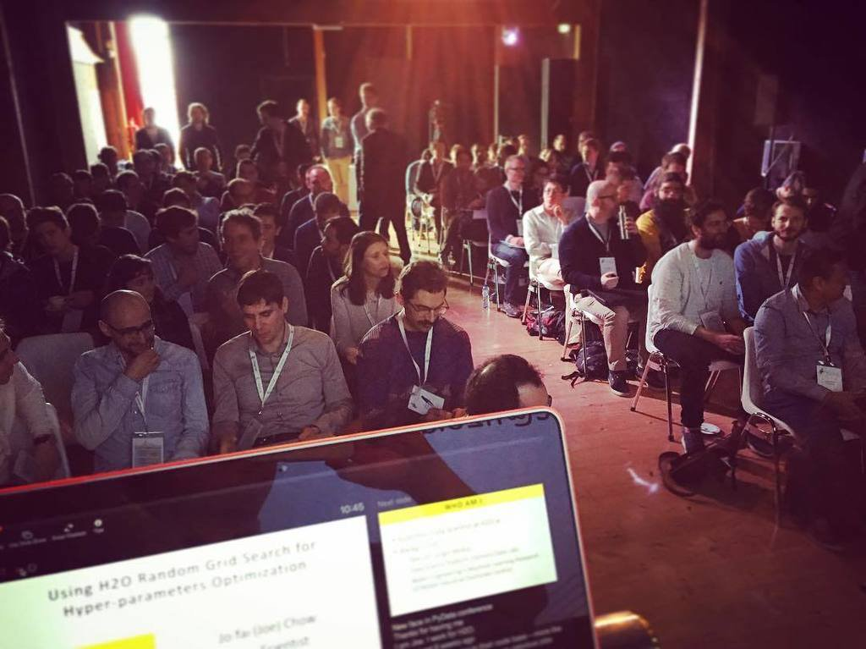
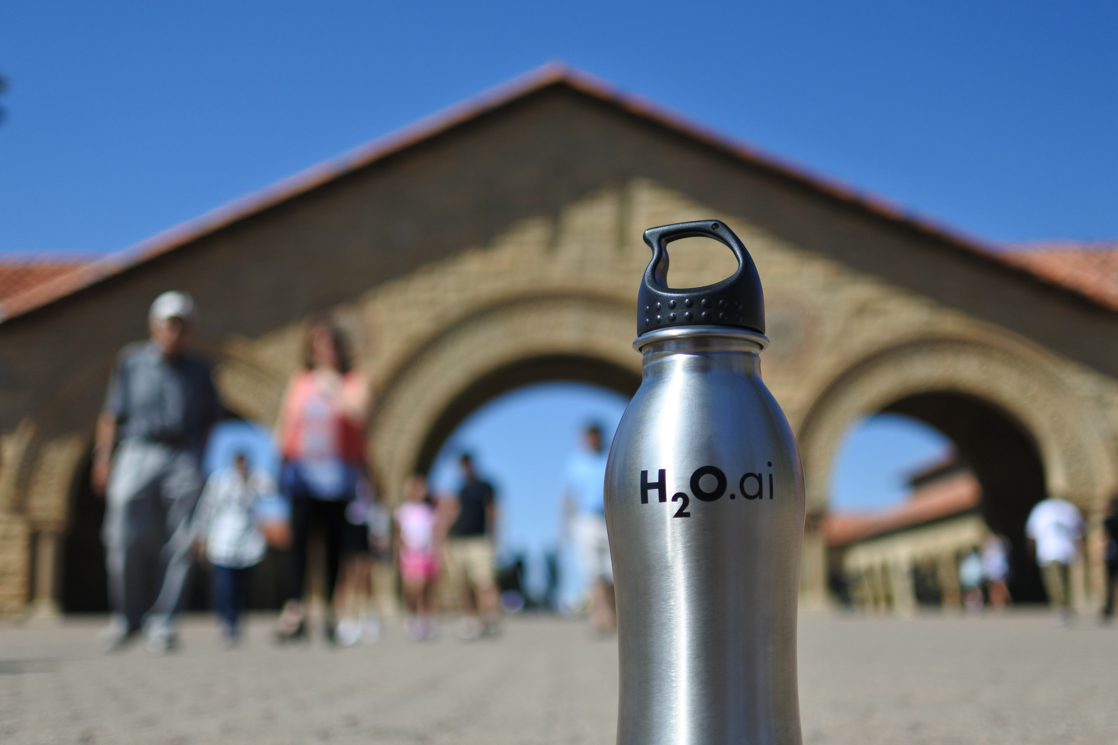
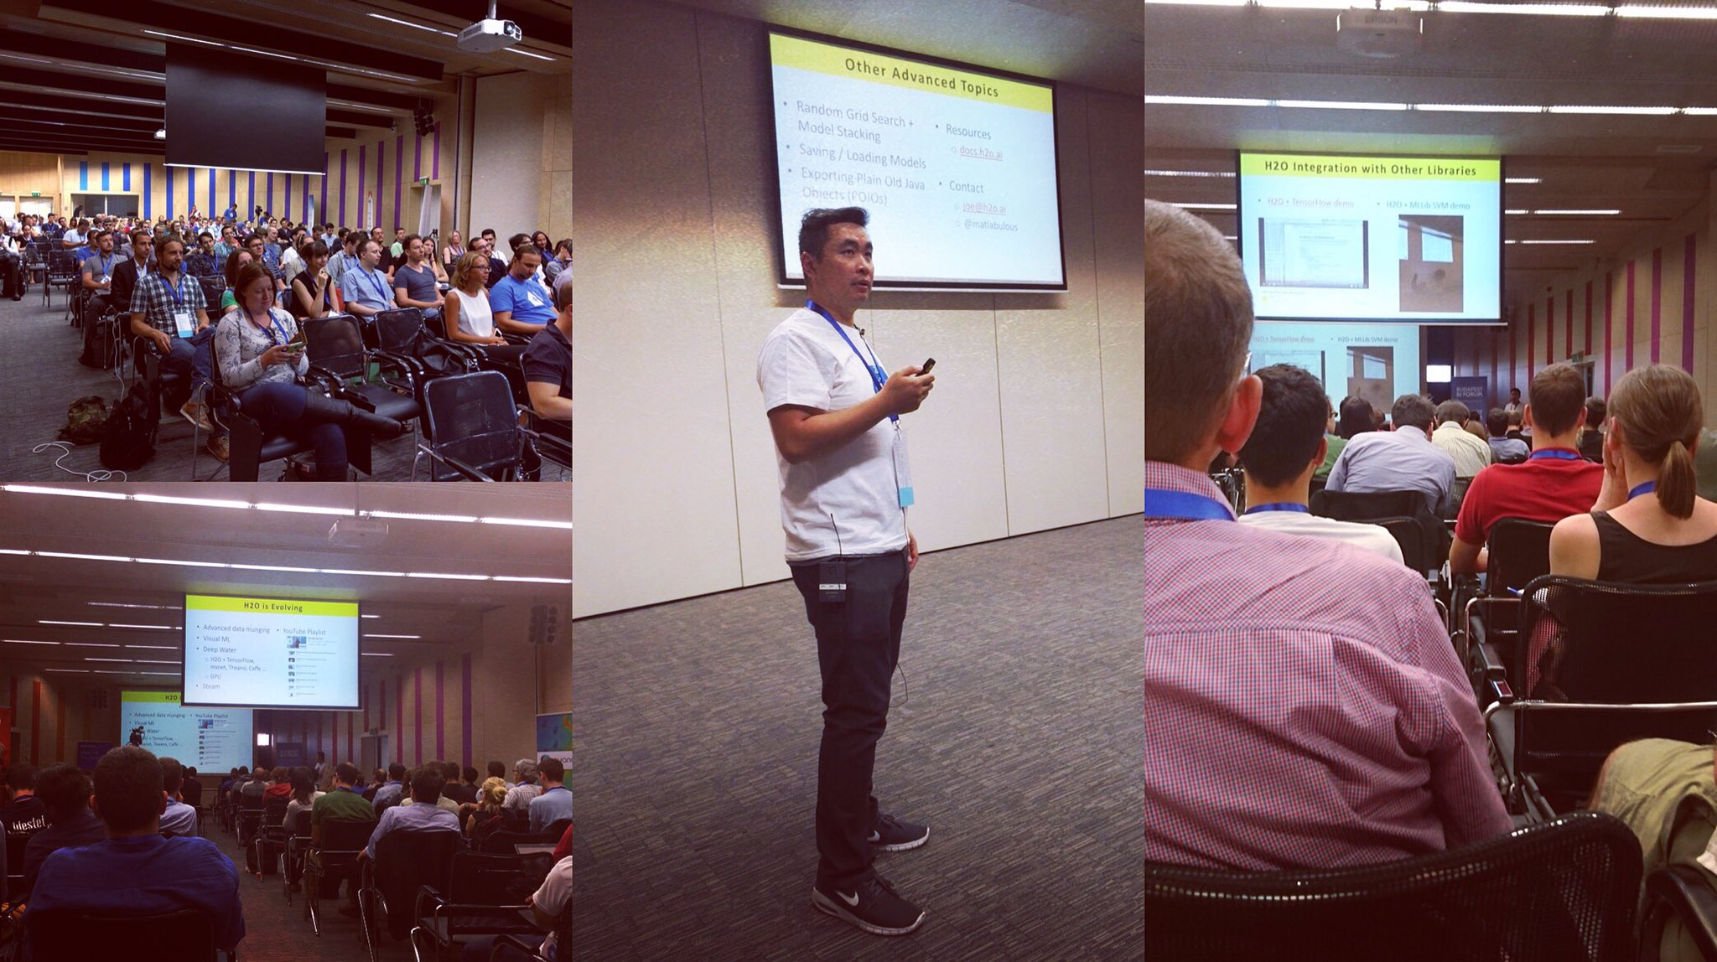
H2O Around the World
London Kaggle Meetup
Strata Hadoop
Chelsea Football Club
PyData
Amsterdam
useR! 2016
Stanford
satRdays
Budapest

Slide 37
What’s Next?

Slide 38
Recap: H2O’s Mission
Machine Learning for EVERYONE
Photo credit: Virgin Media

Slide 39
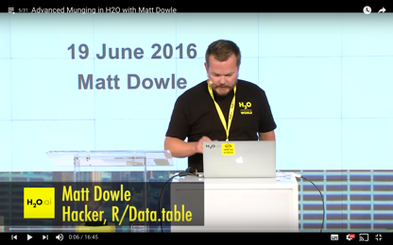
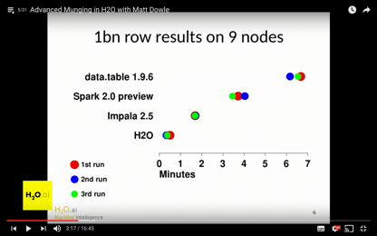
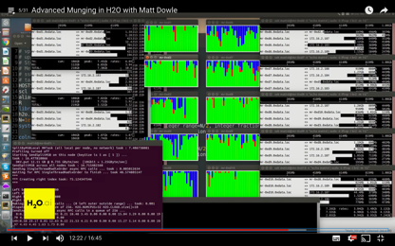
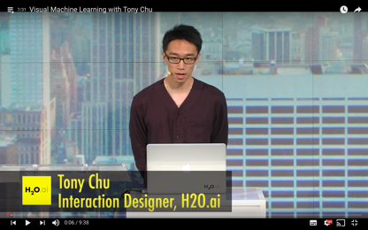
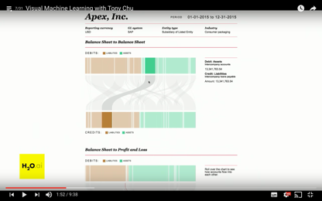
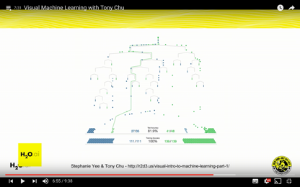
H2O is Evolving
H2O Open Tour NYC YouTube Playlist
Advanced data munging
Visual ML
Deep Water (2nd talk)
Sparkling Water (3rd talk)
Steam
New data science platform

Slide 40


Merci Beaucoup!
Jiqiong (Ji) Qiu
Franck Bardol
Igor Carron
Slides & Code
bit.ly/h2o_paris_1
Contact
joe@h2o.ai
@matlabulous
github.com/woobe

